Slide 1


Slide 2
Agenda for Today
1
Knowing the presenters
4
No-Go
Non-MSME Supplier
No-Go
Our Team
2
Understanding the Information
5
Recommendation
The Data
!deas
All questions matter, can provide valuable knowledge and understanding.
3
Non-MSME Supplier
Non-MSME
6
Q&A

Slide 3
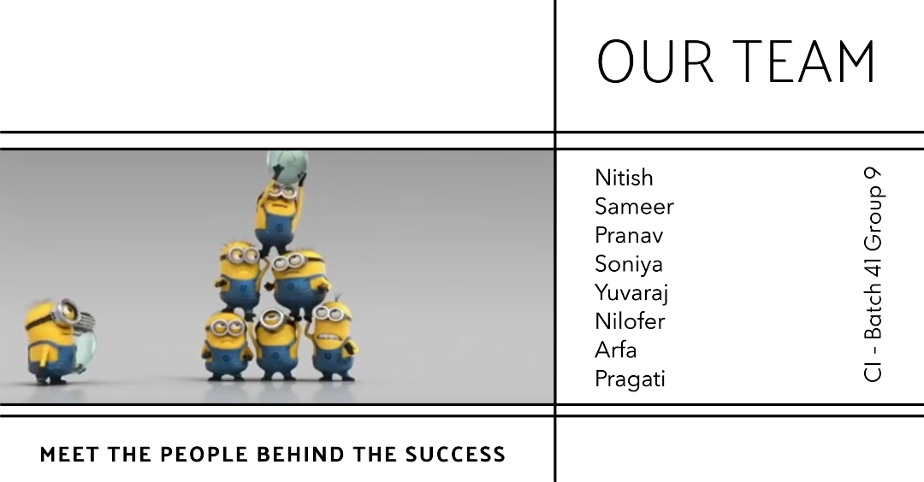

Slide 4
35
Suppliers supply various materials.
#Suppliers
$5.64B
Volume of materials purchased.
791
Purchase Volume
Total parts belongs to 39 Part Family
Parts

Slide 5
Evaluating Non-MSME Suppliers
Key Suppliers
Payment Terms
Volume
Commodity
Convenience
Of these suppliers 4 are of Ferrous Supplier & 8 of them Aluminium related to commodities
There are 6 suppliers who can supply Fe & Ai related Commodities for both casting & machining process
We have 12 Non-MSME Suppliers in which No-GO are 5
All of them have 90 days exept GPL who is No-Go supplier
Purchase Volume for these suppliers contribute about $1.67bn
5 No-Go Non-MSME Suppliers contribute about $711.82M

Slide 6
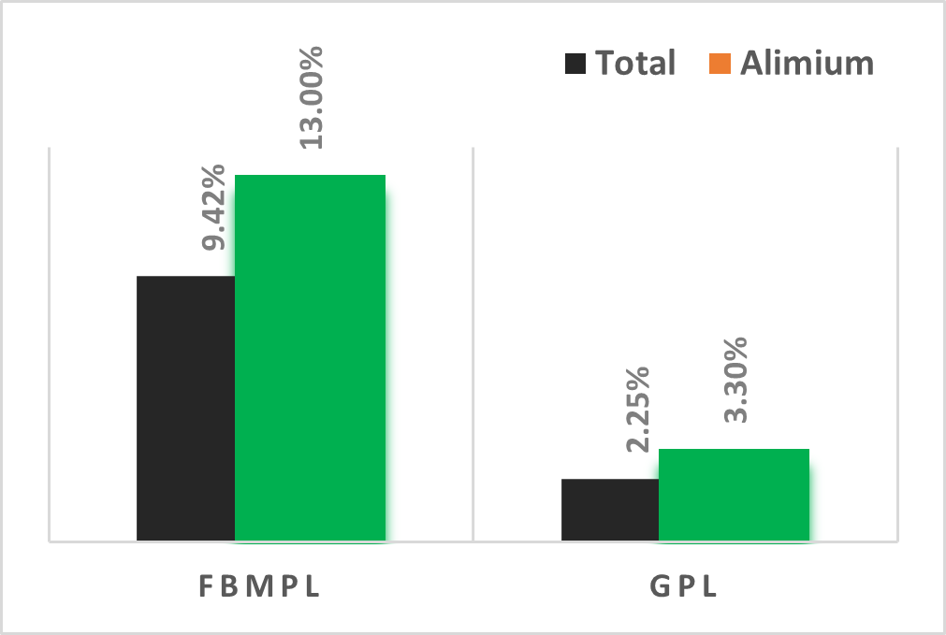
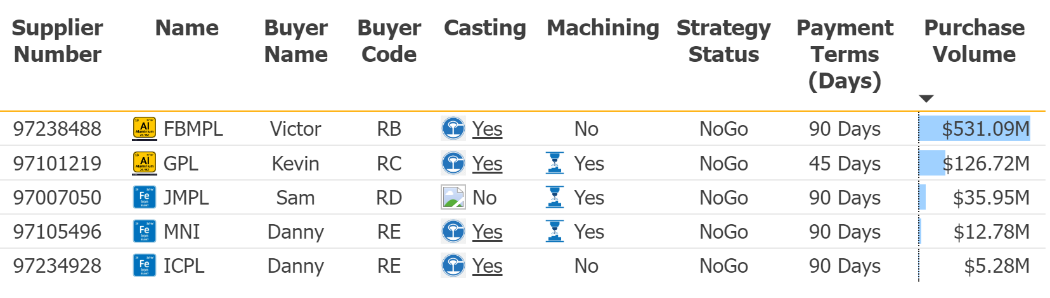
Evaluating Business with Non-MSME
No-Go Suppliers
The top two Non-MSME Suppliers are FBMPL and GPL both combined contribute 11.67% for overall purchase volume and for Aluminium it’s about 16.30% which considerably higher side.
The Aluminum business is very important to us since it contribute about $3.54bn of our overall purchase volume of $5.64bn which is 63% of our purchase volume considering these two there contribution for is crucial for our business success.

Slide 7
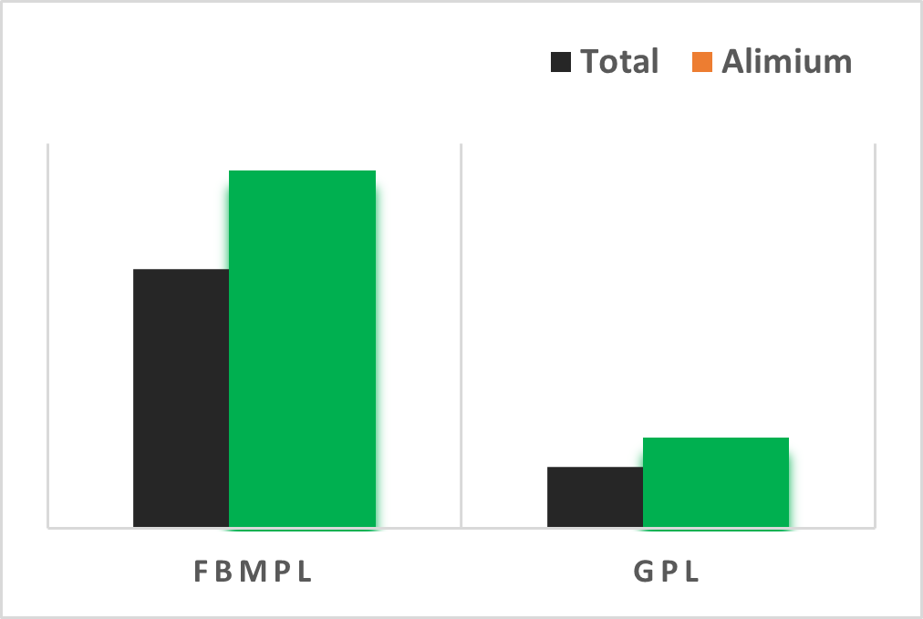
Recommendation to Reduce Dependency
on Non-MSME Suppliers
Our recommendation based on study is “Planned Obsolescence” for FBMPL here we can start slowly to reduce dependency in stages until we reach obsolescence. Immediate reduction may cause heavy losses, supply chain delays and legal problems. For others this may work very quickly.
Our 2nd recommendation is, even though GPL is small supplier and can supply Fe & Ai related Commodities for both casting & machining process. We may keep them for “Just In Case” type of scenarios since their supply range is very good.
Our Final recommendation is to implement, “Just-in-time Inventory” can be a complex and challenging strategy to implement while it comes with many business advantages like (a) Reduction in Inventory cost (b) Improved efficiency (c.) Increased flexibility and fine production quality.

Slide 8
Now Floor is open for Q & A
Thank You

